Slide 1
Surface Mount Soldering & Pick-And-Place

Slide 2
Surface Mount Soldering (in Swarm)

Slide 3
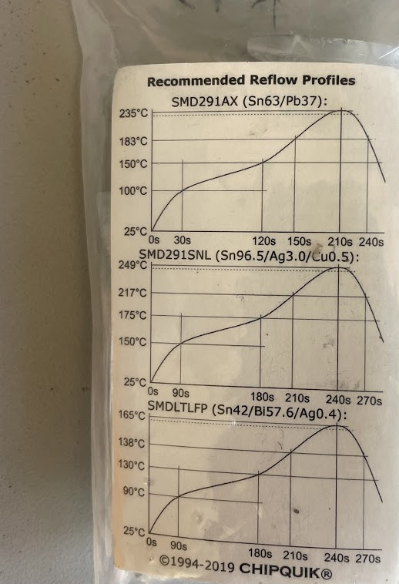
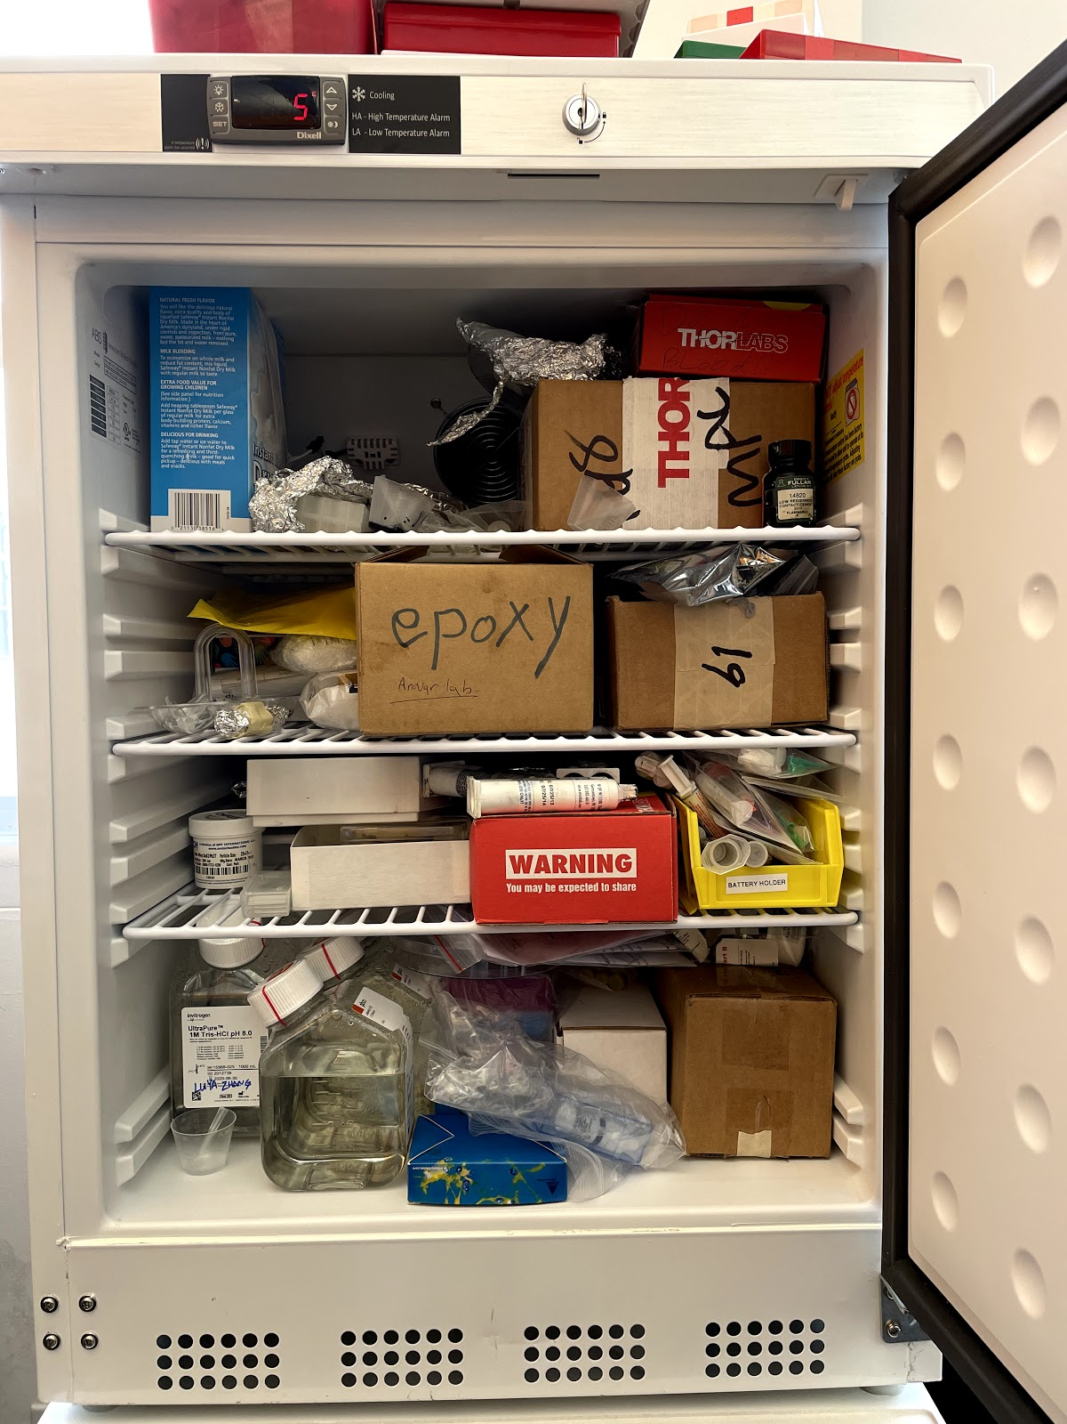
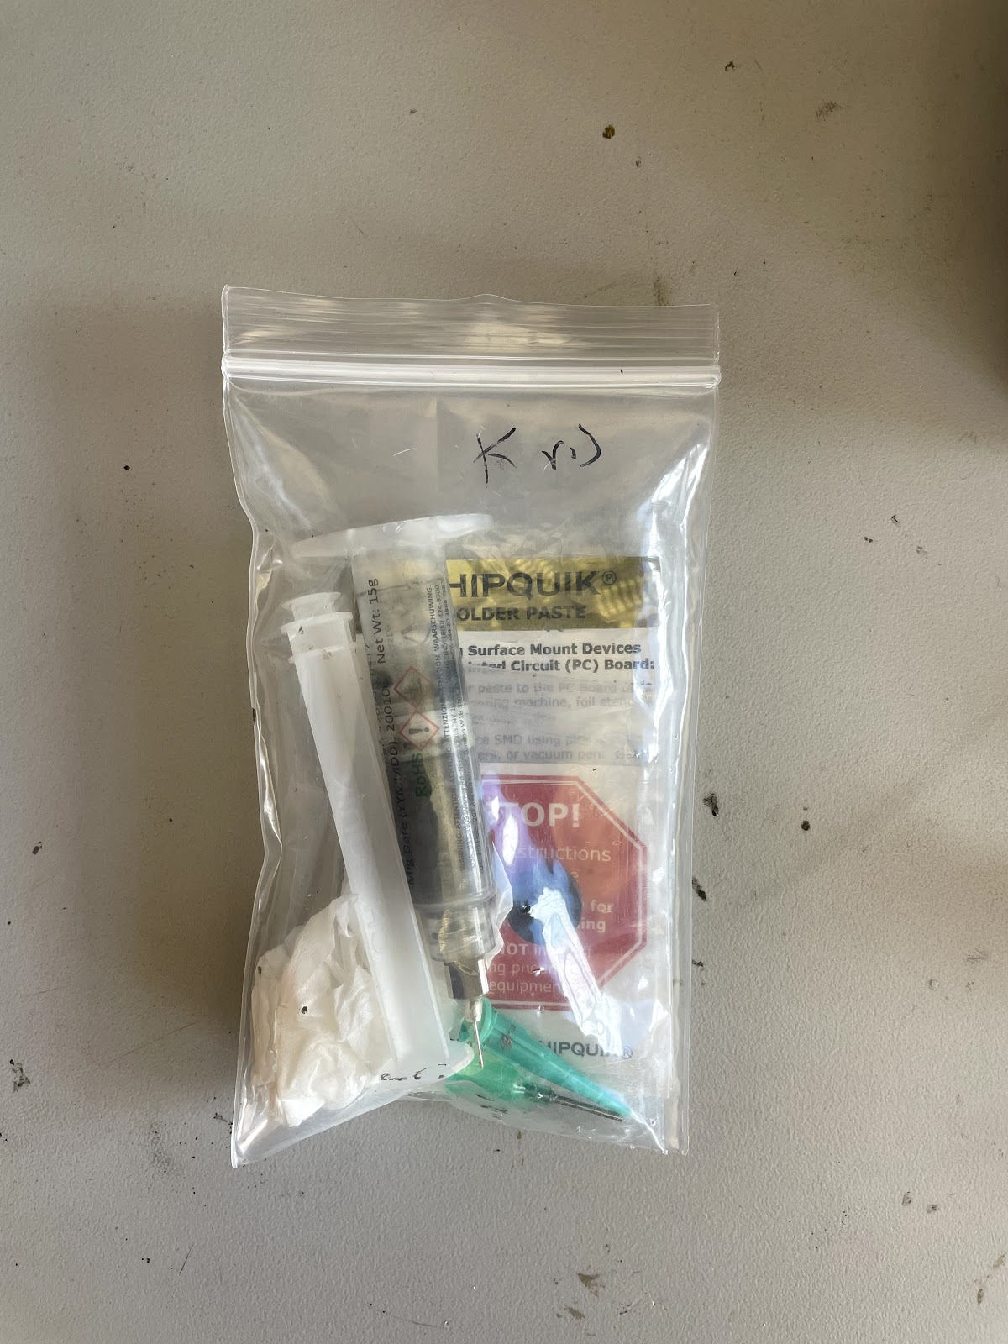
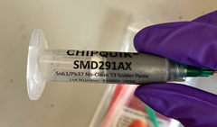
Surface Mount Soldering
Different types of paste have different temperature requirements for reflow (the card can be found in one of the ChipQuik bags).
Wear gloves + get the solder paste
We have several types of solder paste. All of them should be in small ChipQuik bags.

Slide 4
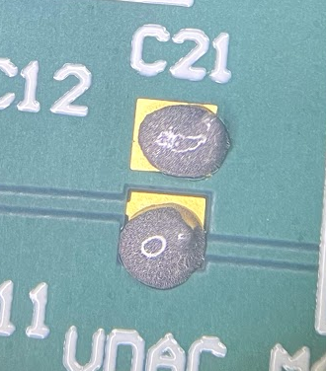
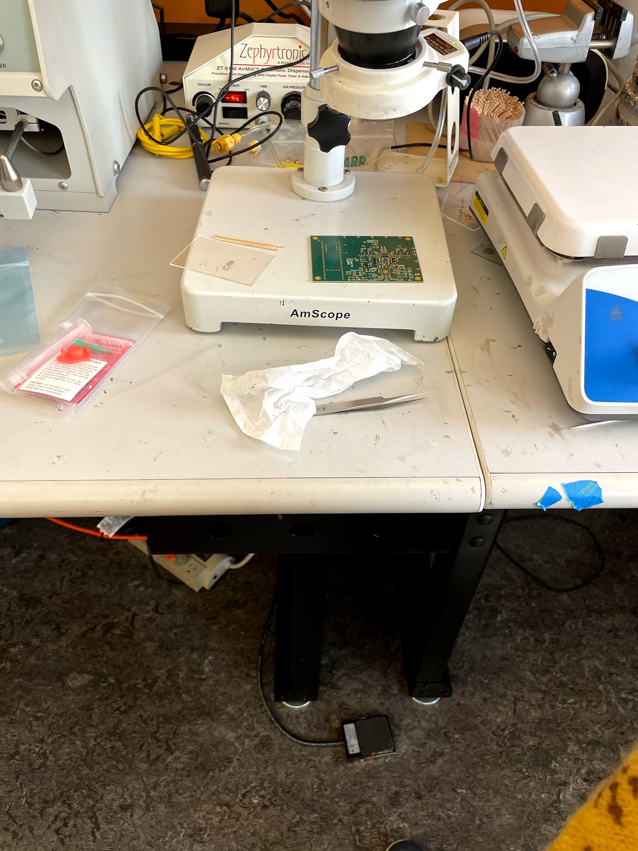
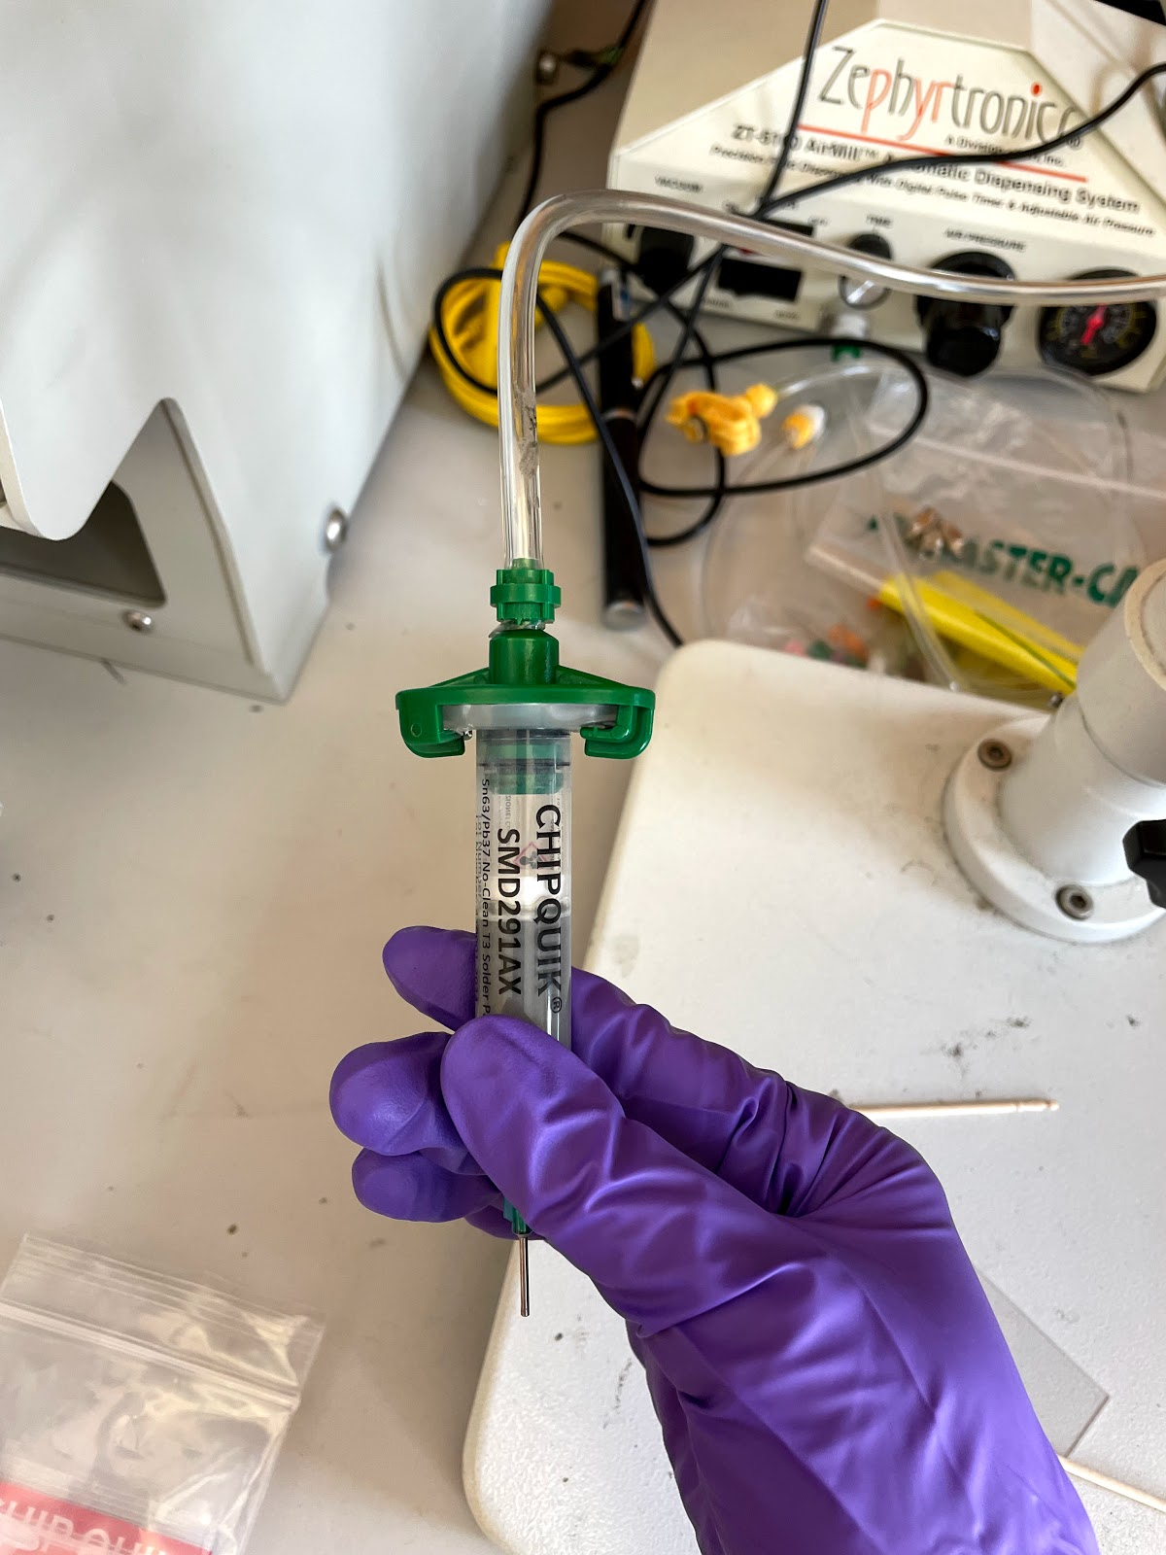
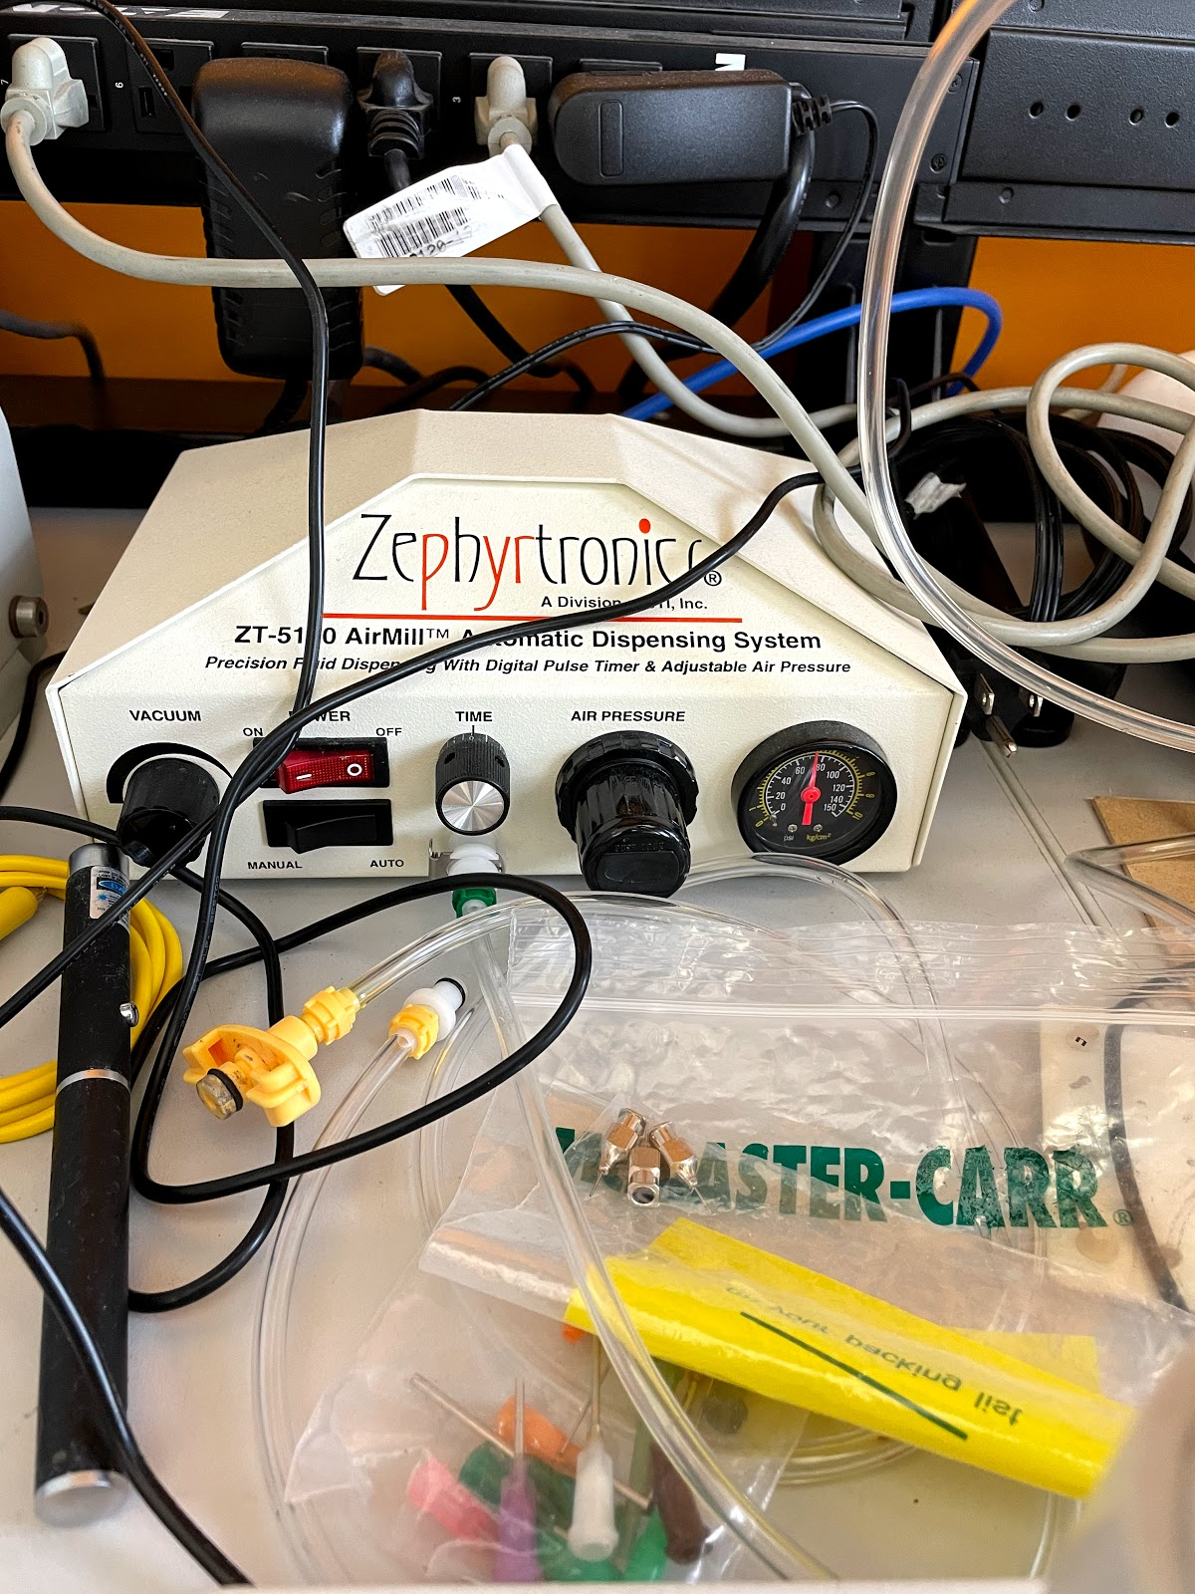
Surface Mount Soldering
Recommend placing a visible gloop over an open area near-ish the board edge if you’re going to use the reflow oven. This is for visibility.
Gloop down the solder paste
Attach the syringe to the pump.
I don’t recommend changing air pressure (it will affect solder output rate)
This is a lot of solder; if the pads were any closer, they might short together when the solder reflows. You can remove excess solder with a toothpick. Sometimes it’s okay to have a bridge before reflow if you don’t have much solder to begin with; the solder will tend to reflow toward the pads (think of water beading).
Pressing the foot pedal will use air to push solder out of the syringe. It may take a few pumps for a single gloop.
Top: Turn on
Bottom: Auto = short bursts (recommended), Manual = continuous glooping

Slide 5
Surface Mount Soldering
Place components (tweezers or pick-and-place)
Check component direction! e.g. diodes, symmetric packages

Slide 6
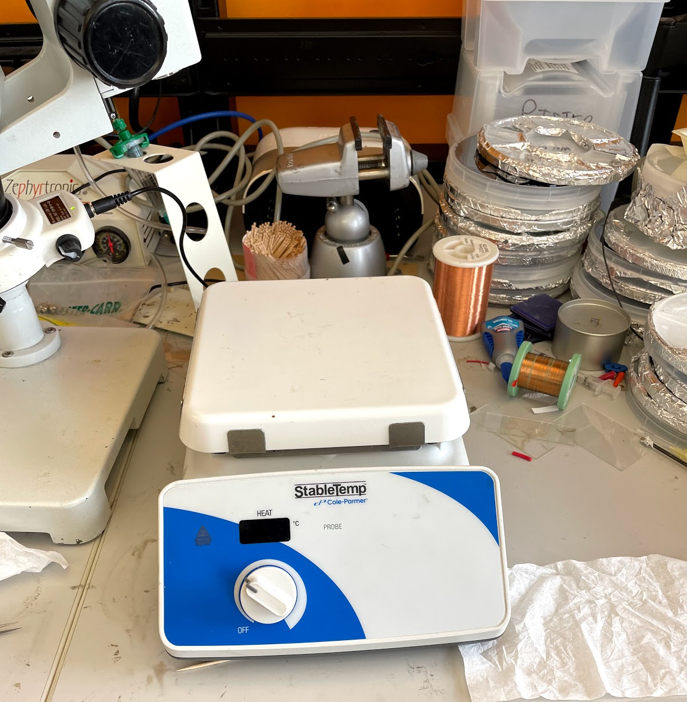
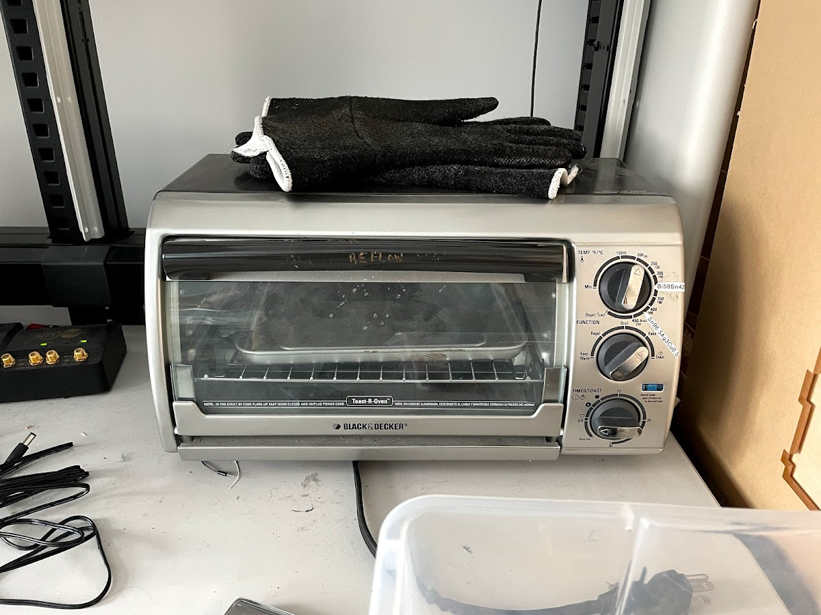
Surface Mount Soldering
Note the temperature requirement for your type of solder
Reflow solder (hot plate or reflow oven)
Heat resistant gloves
Make sure the hot plate temperature is OFF before turning it on (power switch on the left side of the plate). It isn’t off in this photo ☹
Be mindful of the HOT SURFACE indicator
If using the reflow oven, place the board inside such that your test solder spot is visible.

Slide 7
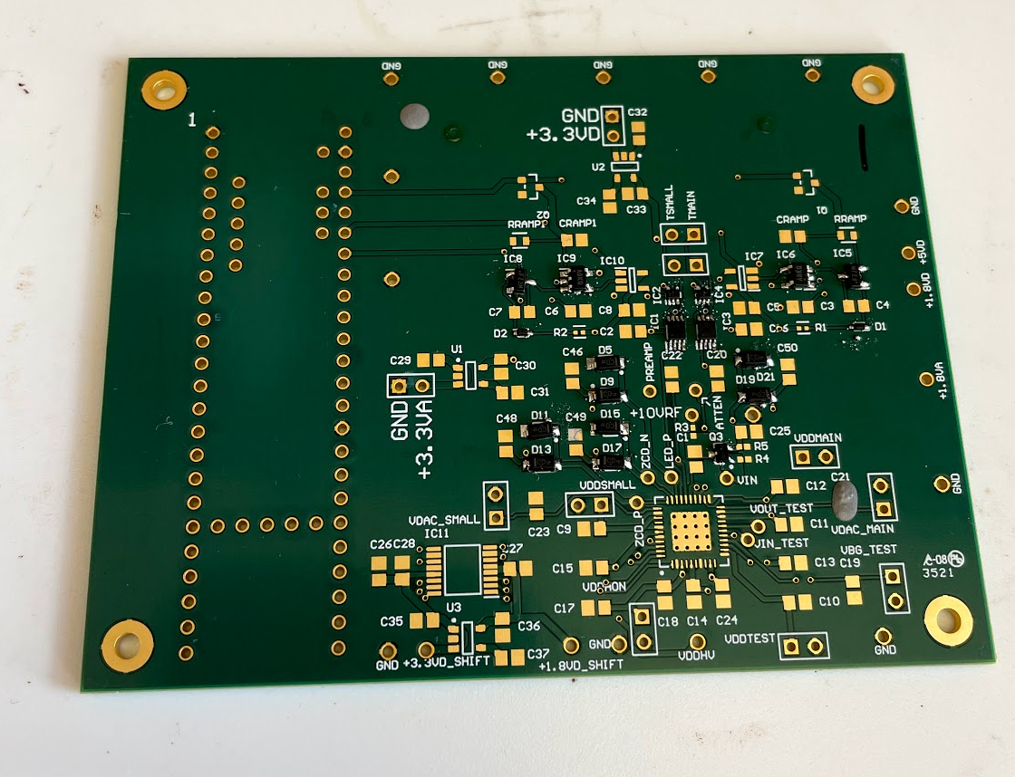
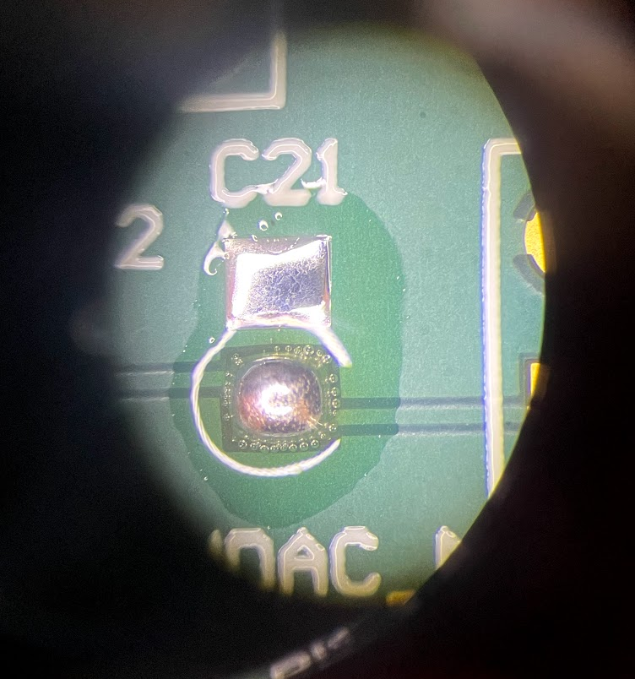
Surface Mount Soldering
Reflow solder (hot plate or reflow oven)
The solder gloops will initially spread out like this...
...then become shiny (the original tiny solder balls in each gloop will have fused together). All of your solder should be shiny when you are done.
Notice how the solder remains within the confines of the pad. I didn’t have a component here so the solder would be visible, but normally there would be a component.

Slide 8
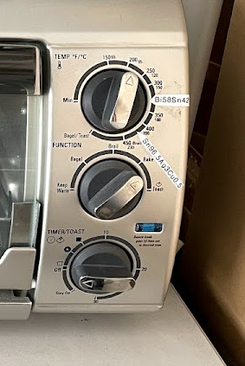
Surface Mount Soldering
Turn off the hot plate/reflow oven
Set this to OFF
Turn off power (switch on the side of the plate)
Set this to OFF

Slide 9
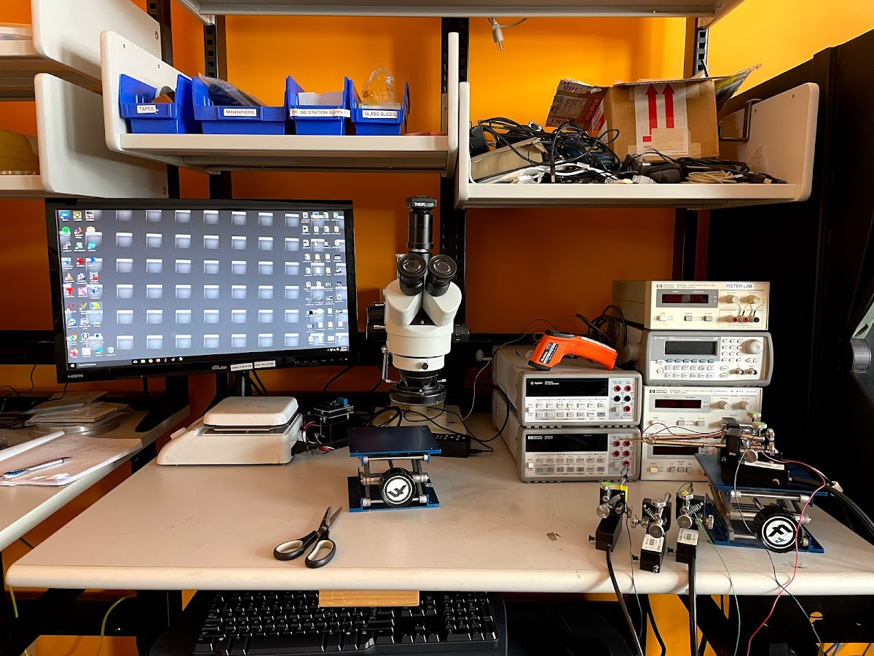
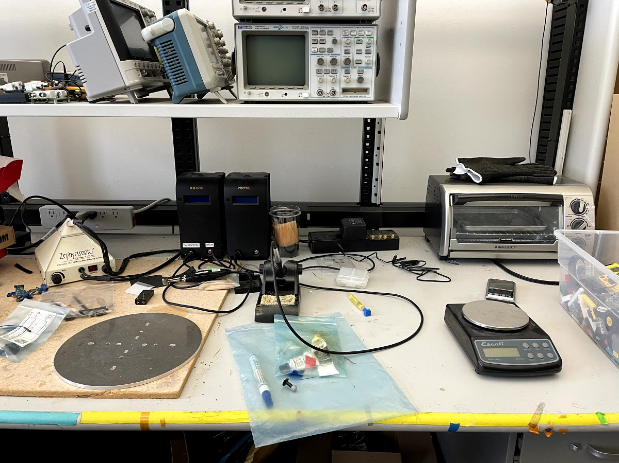
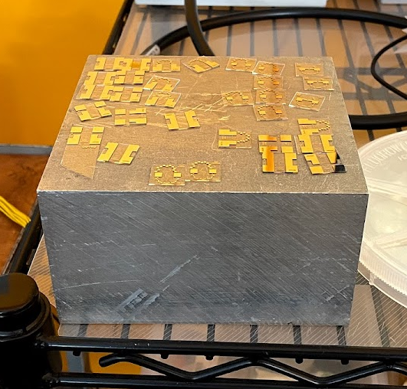
Surface Mount Soldering
Remove and cool boards (recommend using tweezers and/or heat resistant gloves when handling hot boards)
These (not electrically connected) metal blocks make decent heat sinks.
Note that they can become warm when dissipating heat.

Slide 10
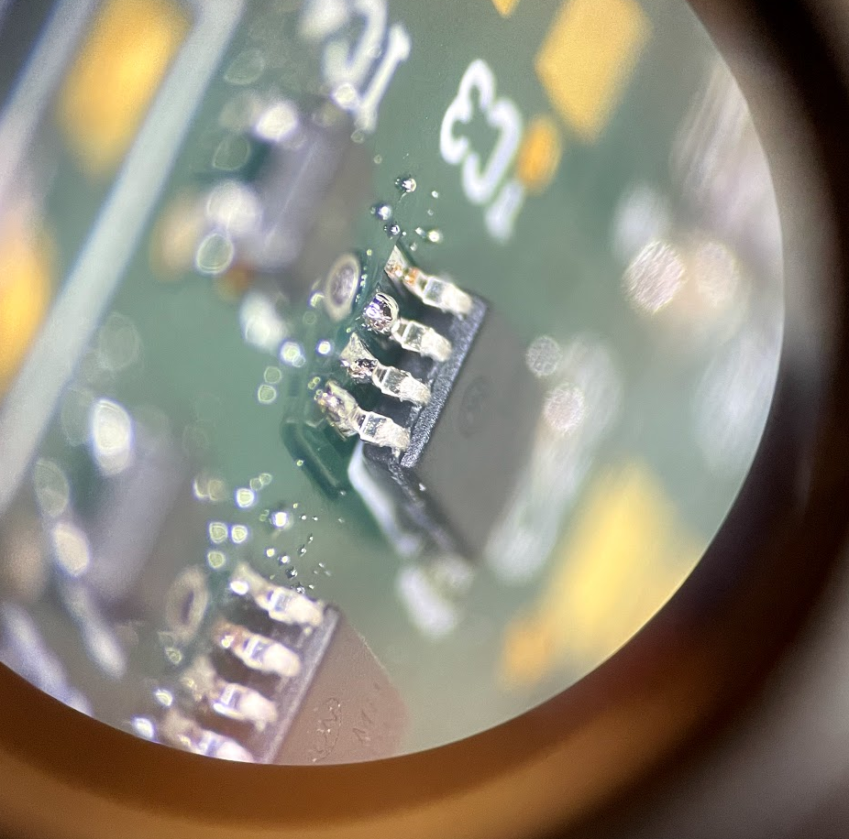
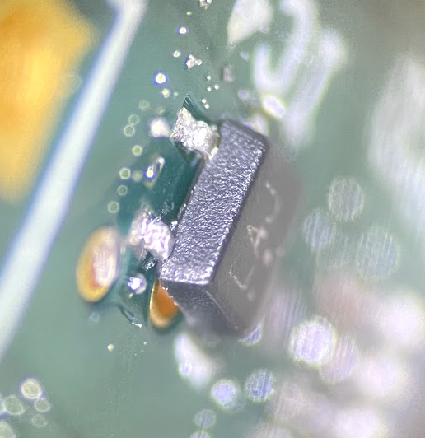
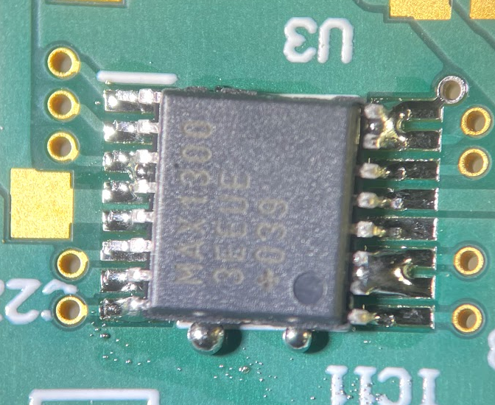
Surface Mount Soldering
Examine your components for shorts and poor connections. Replace components and make fixes as necessary.
Broken leg component leg will need component replacement.
Raised component leg (electrical connection may be poor, and jostling may lift the leg off entirely).
Can be resolved by reheating solder (iron or hot air gun for local heating) and shifting the component.
Solder bridges from using too much solder can cause electrical shorts between closely-spaced pads.
Can usually be fixed with solder wick.

Slide 11
Pick-and-Place

Slide 12
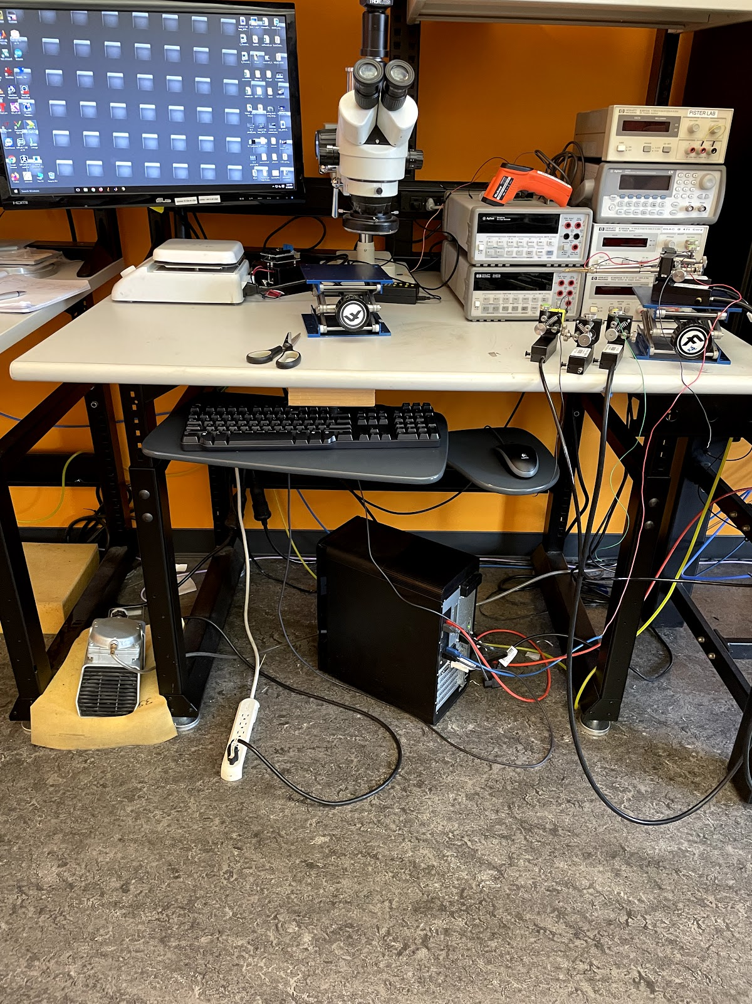
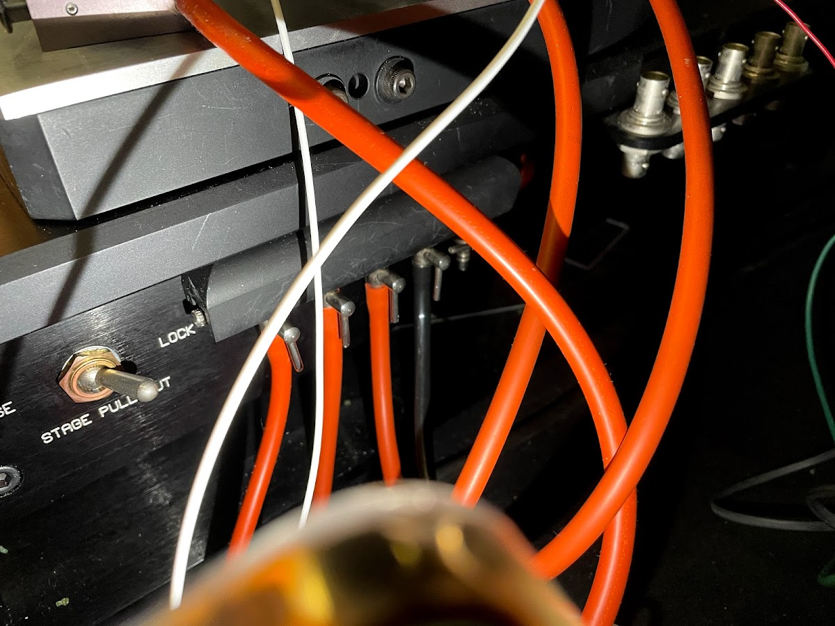
Pick & Place
Turn on the vacuum
On the right side of the probe station (you may need to lift the big black cover), the valve for the black tube should be pointing down.
Turn on this power strip

Slide 13
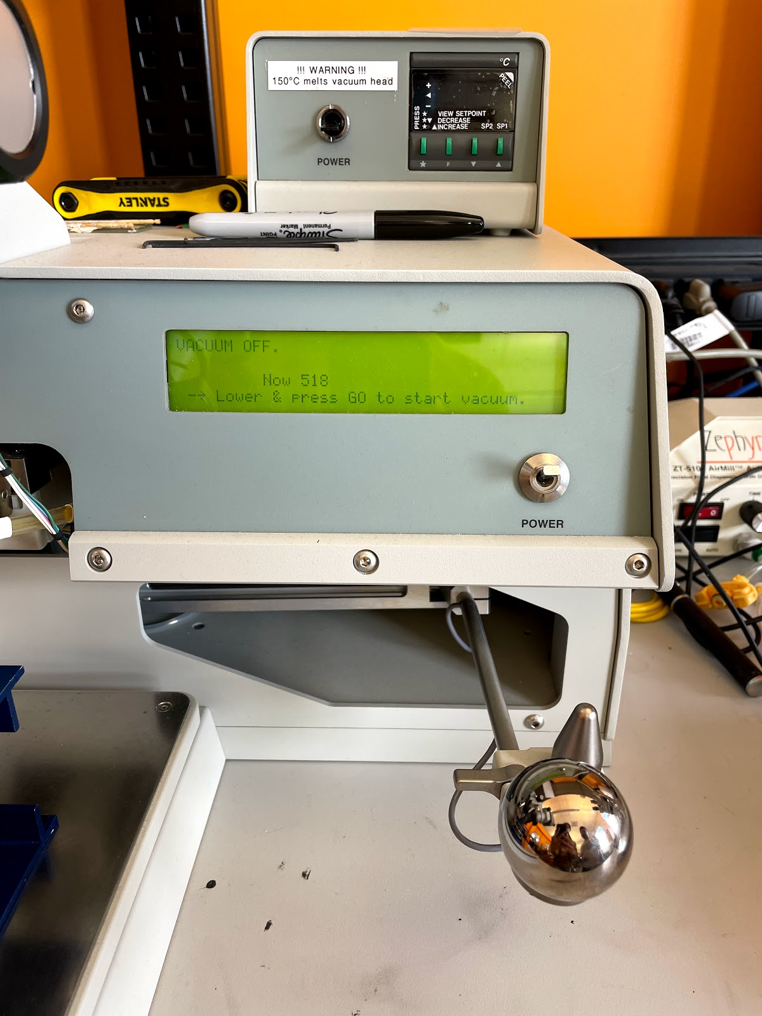
Pick & Place
Turn on the pick-and-placer and set to pick-and-place (not epoxy deposition)
The display is your friend
(1) Turn on power switch
(2) Lower and raise the handle. Note that if you lower it too far, it will set to epoxy deposition (you’ll see it on the screen)

Slide 14
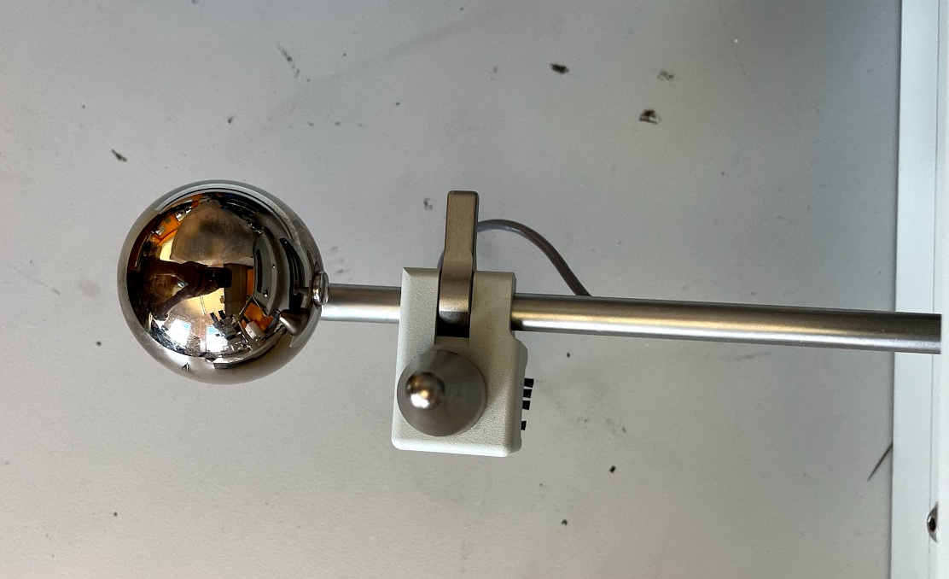
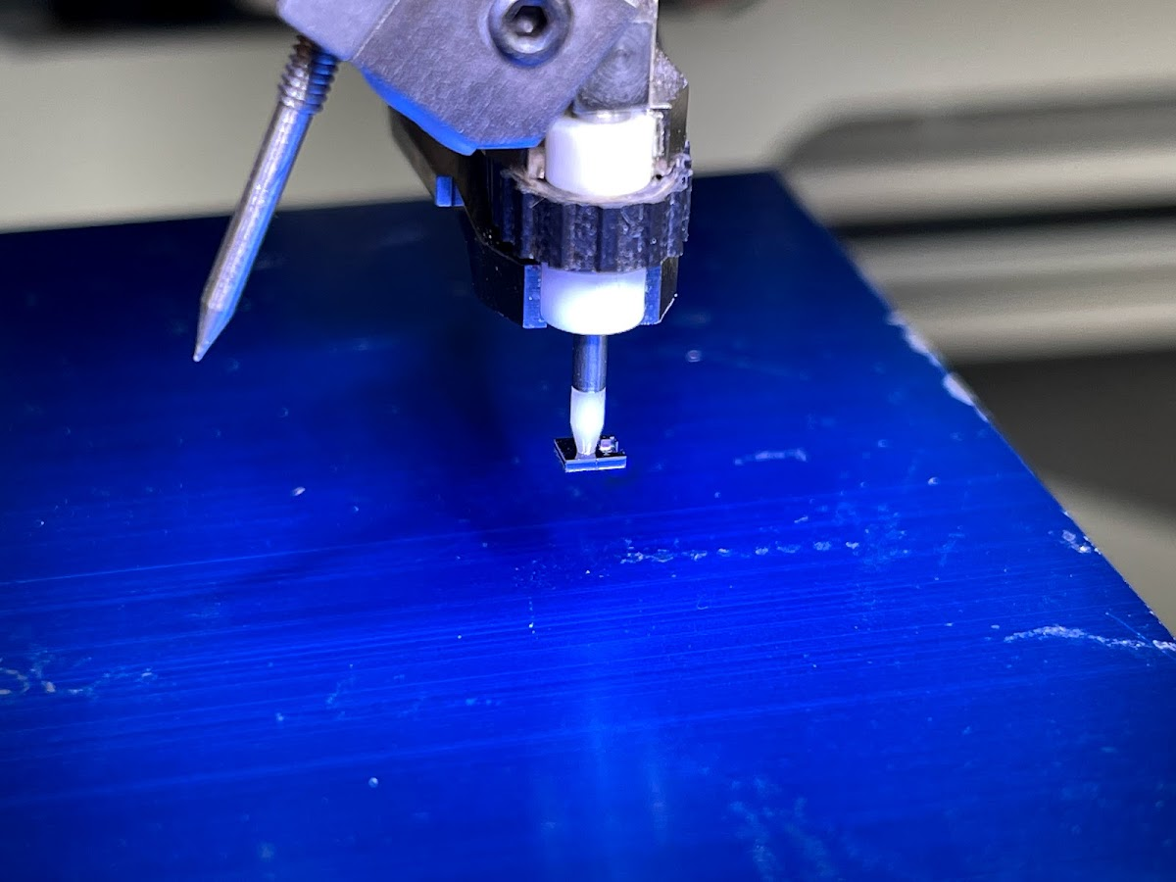
Pick & Place
Use the lever to move the pick-and-placer (viewed through the microscope attachment)
(1) Moving the lever up/down/left/right/forward/backward will move the pick-and-placer (think of it as motion attenuation via mechanical advantage).
(4) Press this button to release the component
Do not touch the pick-and-place tip with your hands (gloved or otherwise)
(2) To pick up a component, bring the pick-and-placer tip down on the component. The vacuum is always running and will pick up the component upon contact.
(3) Rotating this knob will rotate the pick-and-placer (and the component)

Slide 15
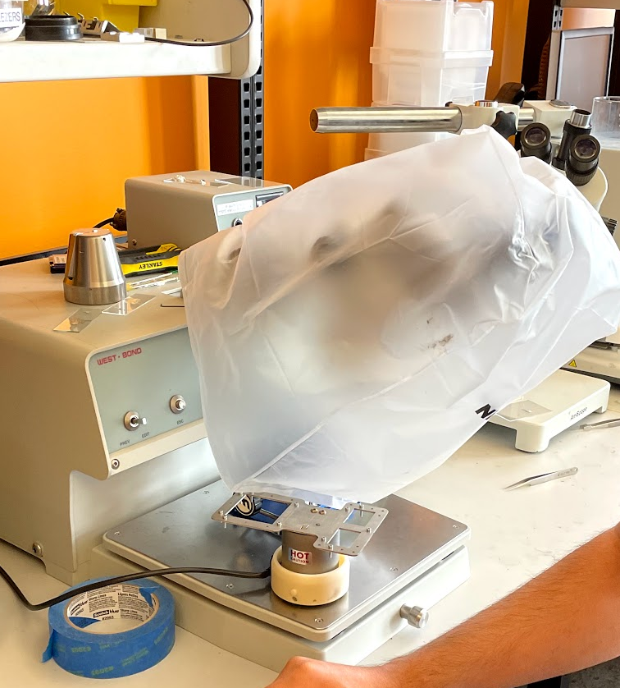
Pick & Place
When done, clean up after yourself
Cover the microscope attachment with the plastic cover
Turn off power
Turn off the power strip (turns off the vacuum pump)
Remove anything you placed on the stage that wasn’t there to begin with

